Slide 1
CCBR1032
Da and Vishal
Our goal is to use RNA sequencing to investigate the expression changes in pathways such as DNA damage, DNA repair, cell cycle signaling, and apoptosis after treatment with a drug combination. We are using established and patient-derived human glioblastoma (brain tumor) cell lines, and treating with a drug combination that induces DNA damage, cell cycle arrest, and apoptosis. Additionally, RNA-Seq would also allow us to observe expression changes in additional pathways which could lead to identification of novel mechanisms of drug action, which we are interested in as well.

Slide 2
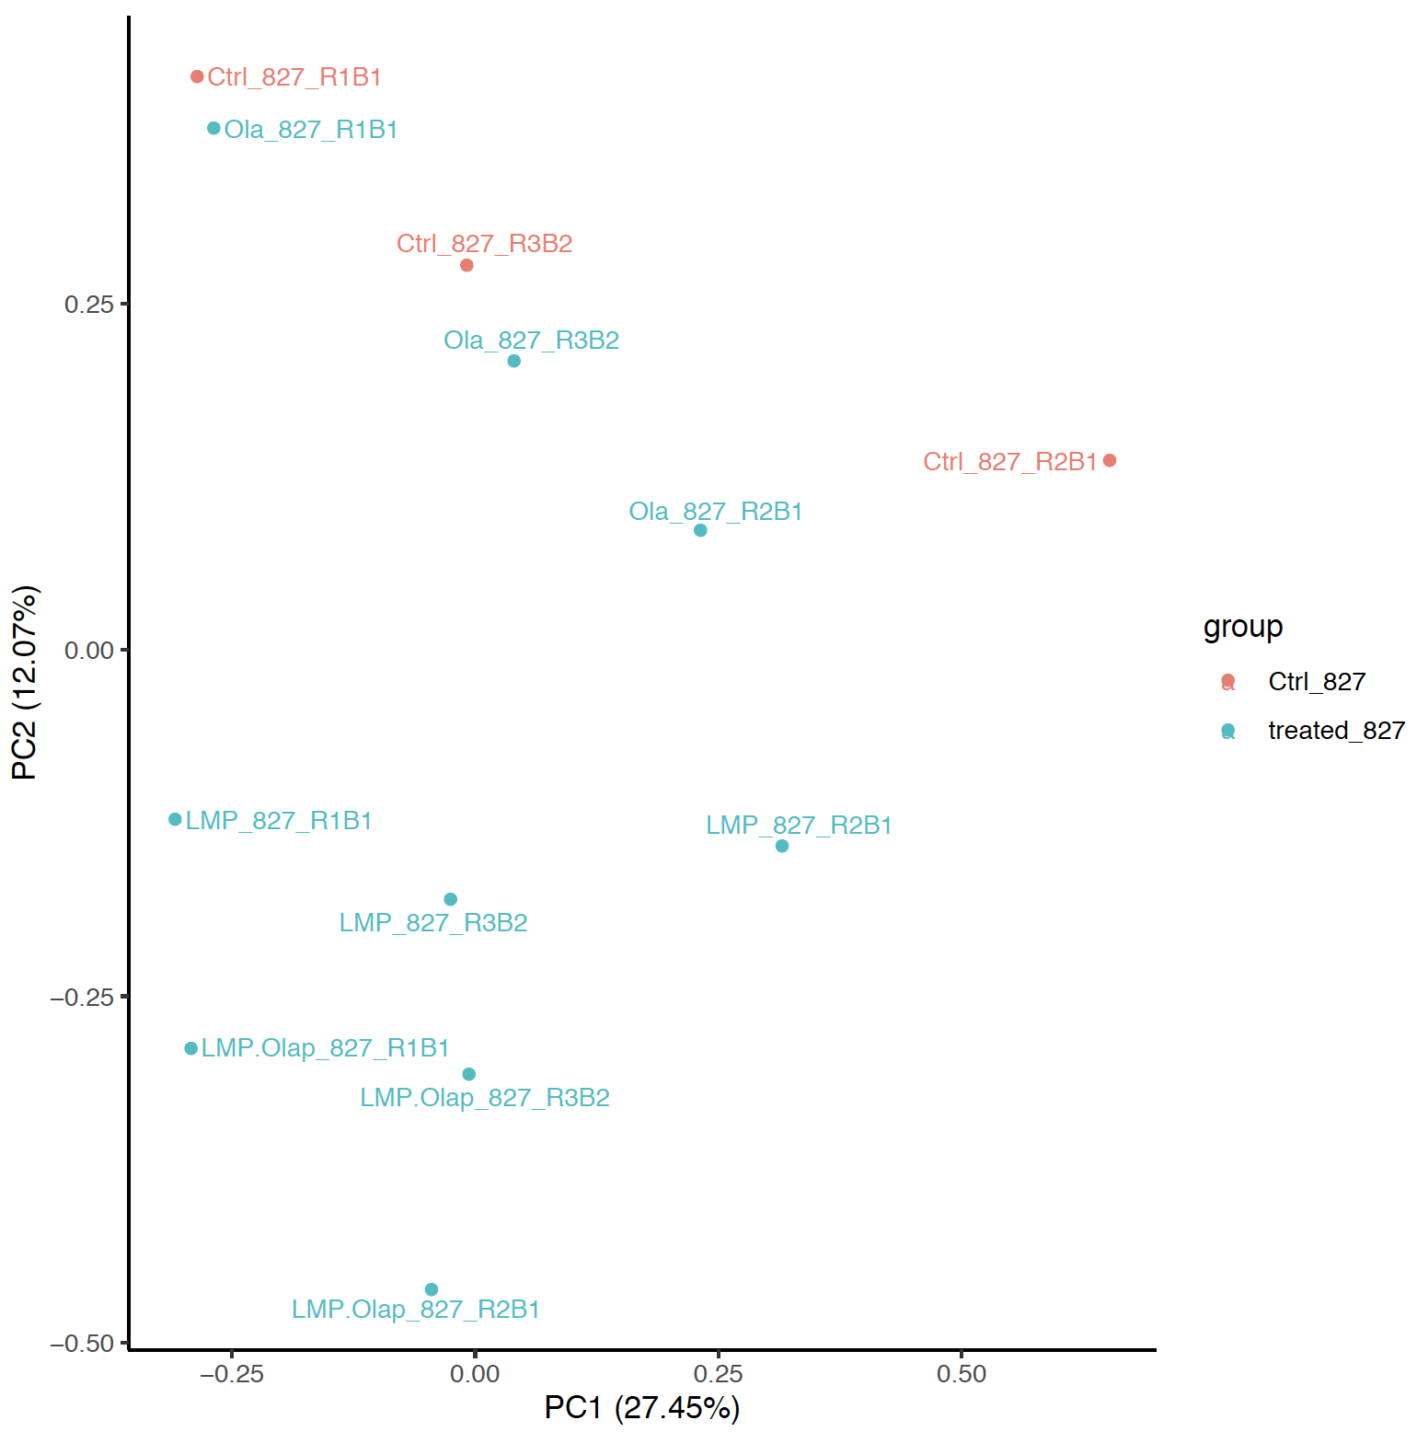
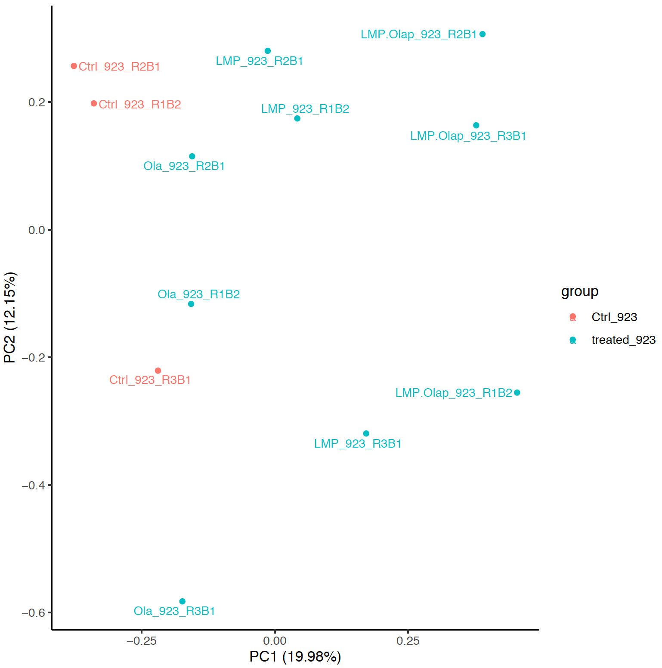
GSC827
GSC923

Slide 3
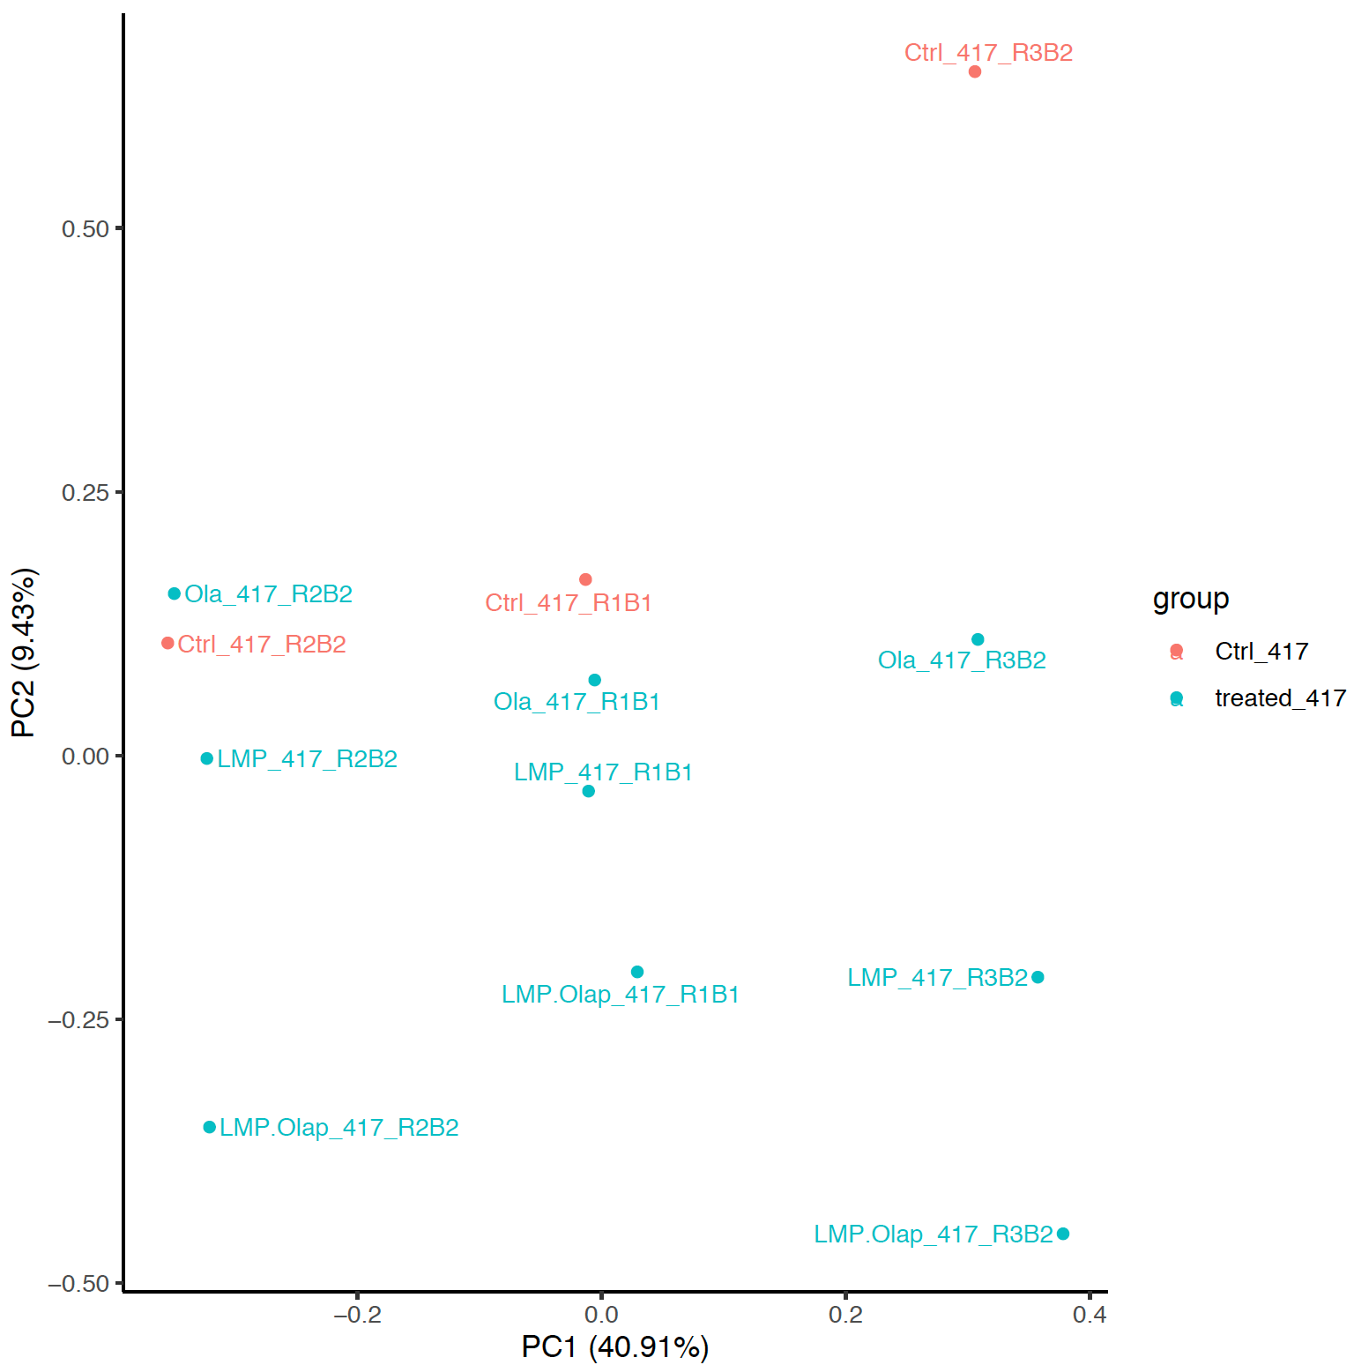
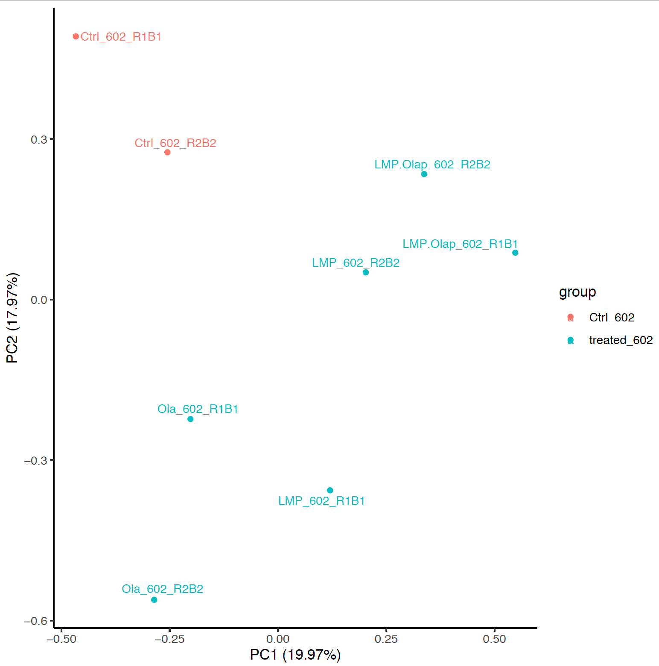
SF10417
SF10602

Slide 4
- Ola_417-Ctrl_417 : 0
- Ola_602-Ctrl_602 : 15
- Ola_827-Ctrl_827 : 0
- Ola_923-Ctrl_923 : 1
- LMP_417-Ctrl_417 : 0
- LMP_602-Ctrl_602 : 41
- LMP_827-Ctrl_827 : 0
- LMP_923-Ctrl_923 : 38
- LMP.Olap_417-Ctrl_417 : 0
- LMP.Olap_602-Ctrl_602 : 88
- LMP.Olap_827-Ctrl_827 : 0
- LMP.Olap_923-Ctrl_923 : 415
- LMP.Olap_417-LMP_417 : 0
- LMP.Olap_602-LMP_602 : 23
- LMP.Olap_923-LMP_923 : 68
- LMP.Olap_827-LMP_827 : 0
- LMP.Olap_417-Ola_417 : 0
- LMP.Olap_602-Ola_602 : 82
- LMP.Olap_827-Ola_827 : 41
- LMP.Olap_923-Ola_923 : 222
DEGs:
Contrast:
Ola – Ctrl(Olaparib Vs. Control): GSC923(GSC827, SF10417, SF10602)
LMP – Ctrl(LMP400 Vs. Control): GSC923(GSC827, SF10417, SF10602)
LMP.Olap - Ctrl(LMP400+Olaparib Vs. Control): GSC923(GSC827, SF10417, SF10602)
LMP.Olap – Ola(LMP400+Olaparib Vs. Olaparib): GSC923(GSC827, SF10417, SF10602)
LMP.Olap – LMP(LMP400+Olaparib Vs. LMP400):
GSC923(GSC827, SF10417, SF10602)
treated-Ctrl(Olaparib, LMP400, LMP400+Olaparib Vs. Control):
GSC923(GSC827, SF10417, SF10602)

Slide 5

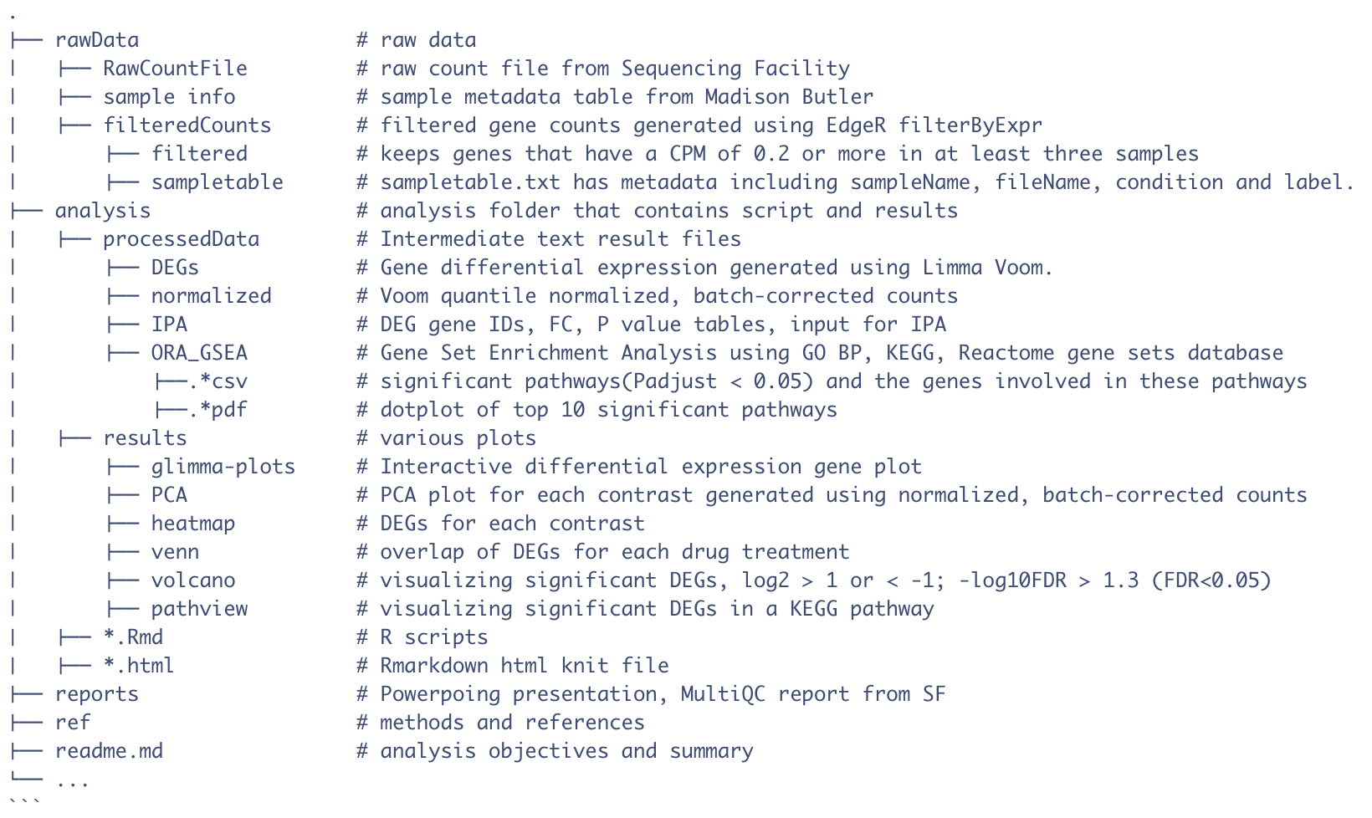

Slide 6
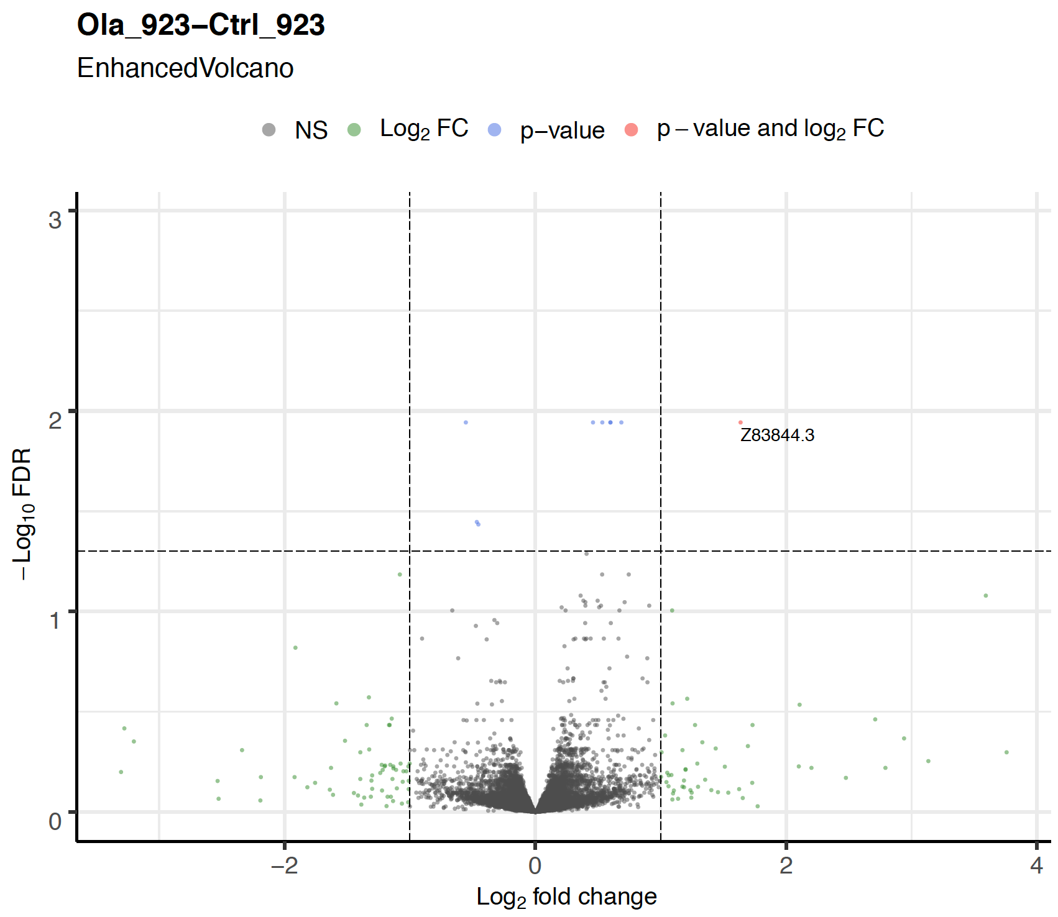
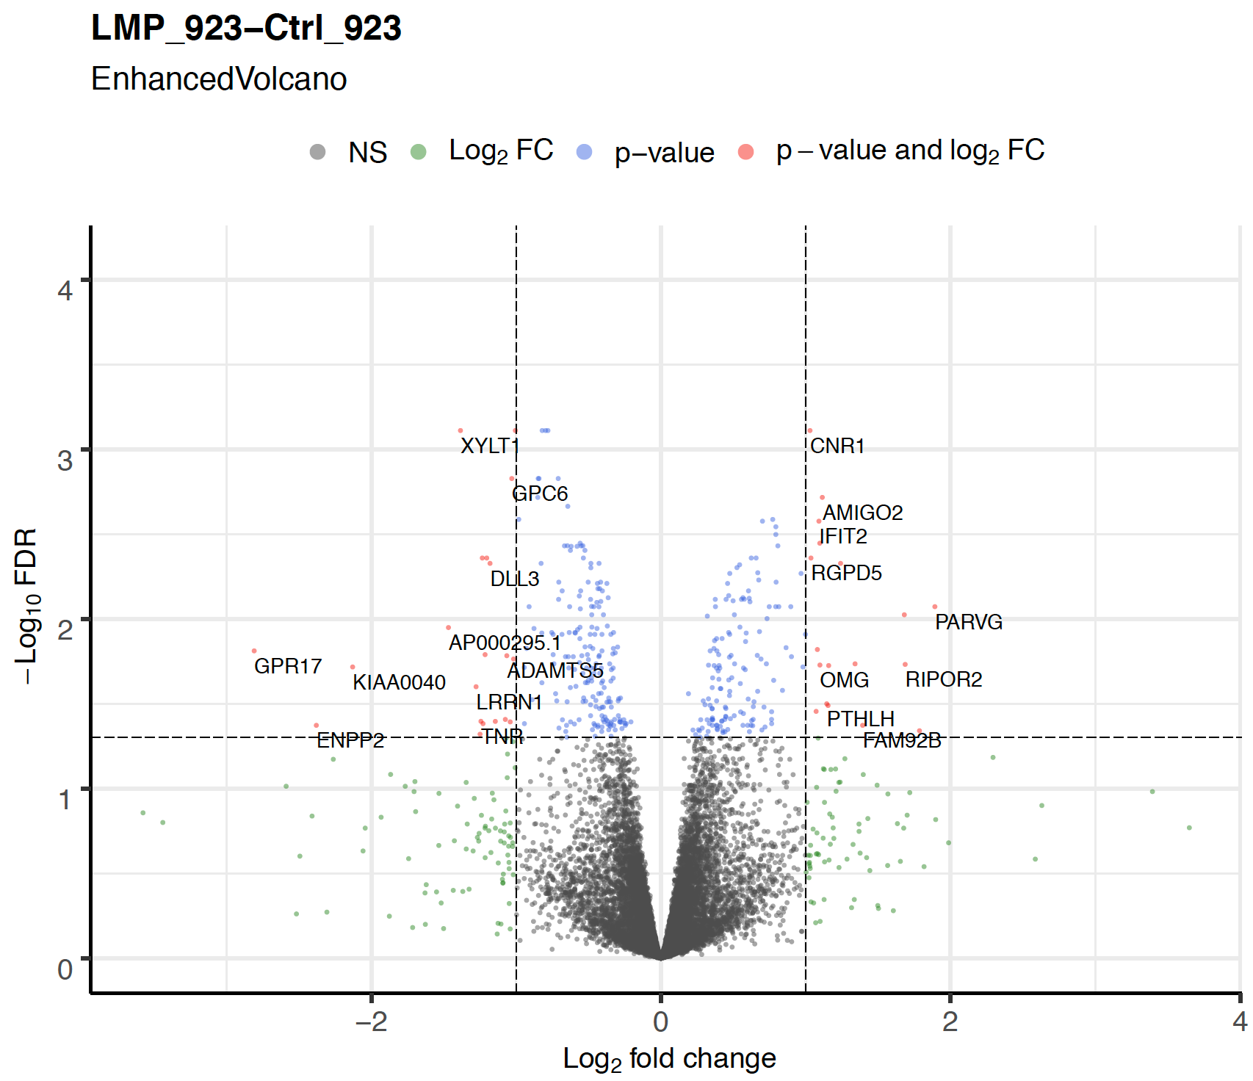
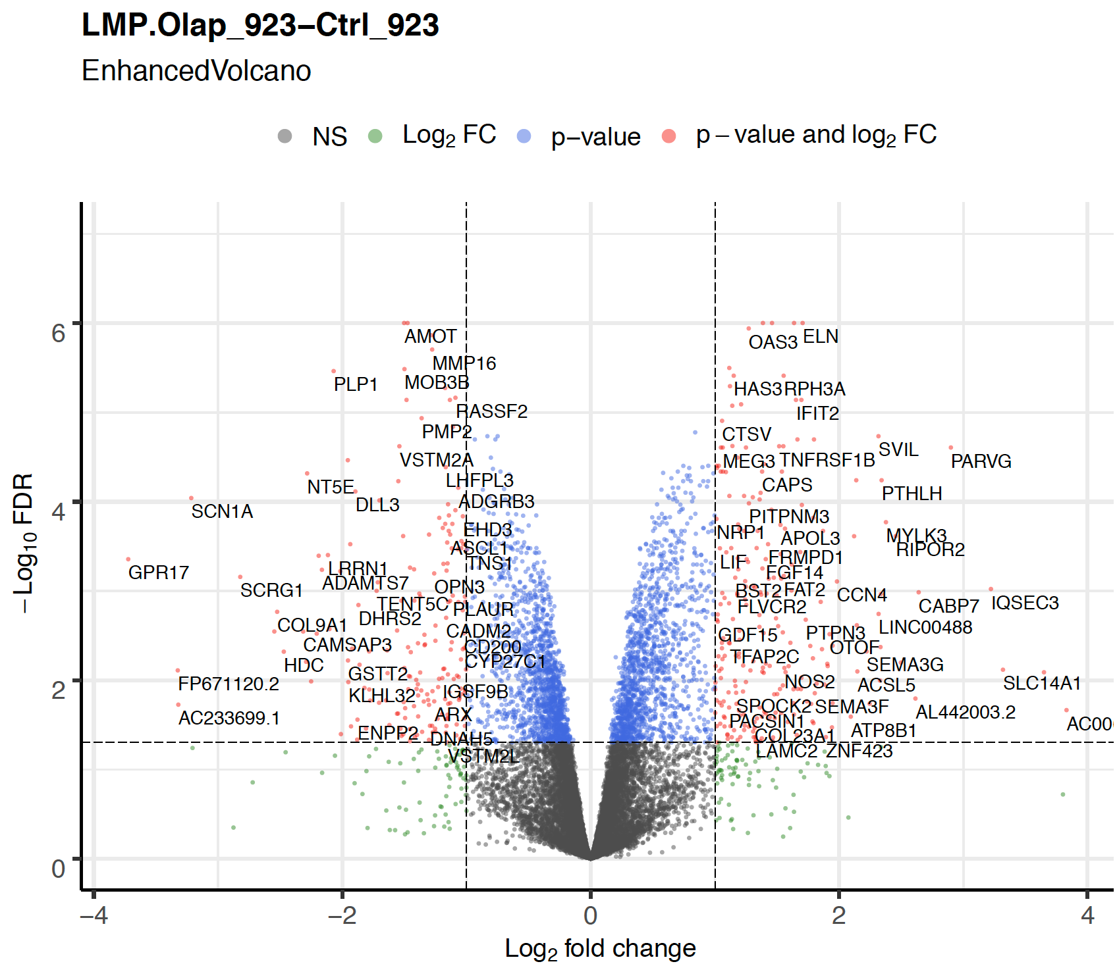
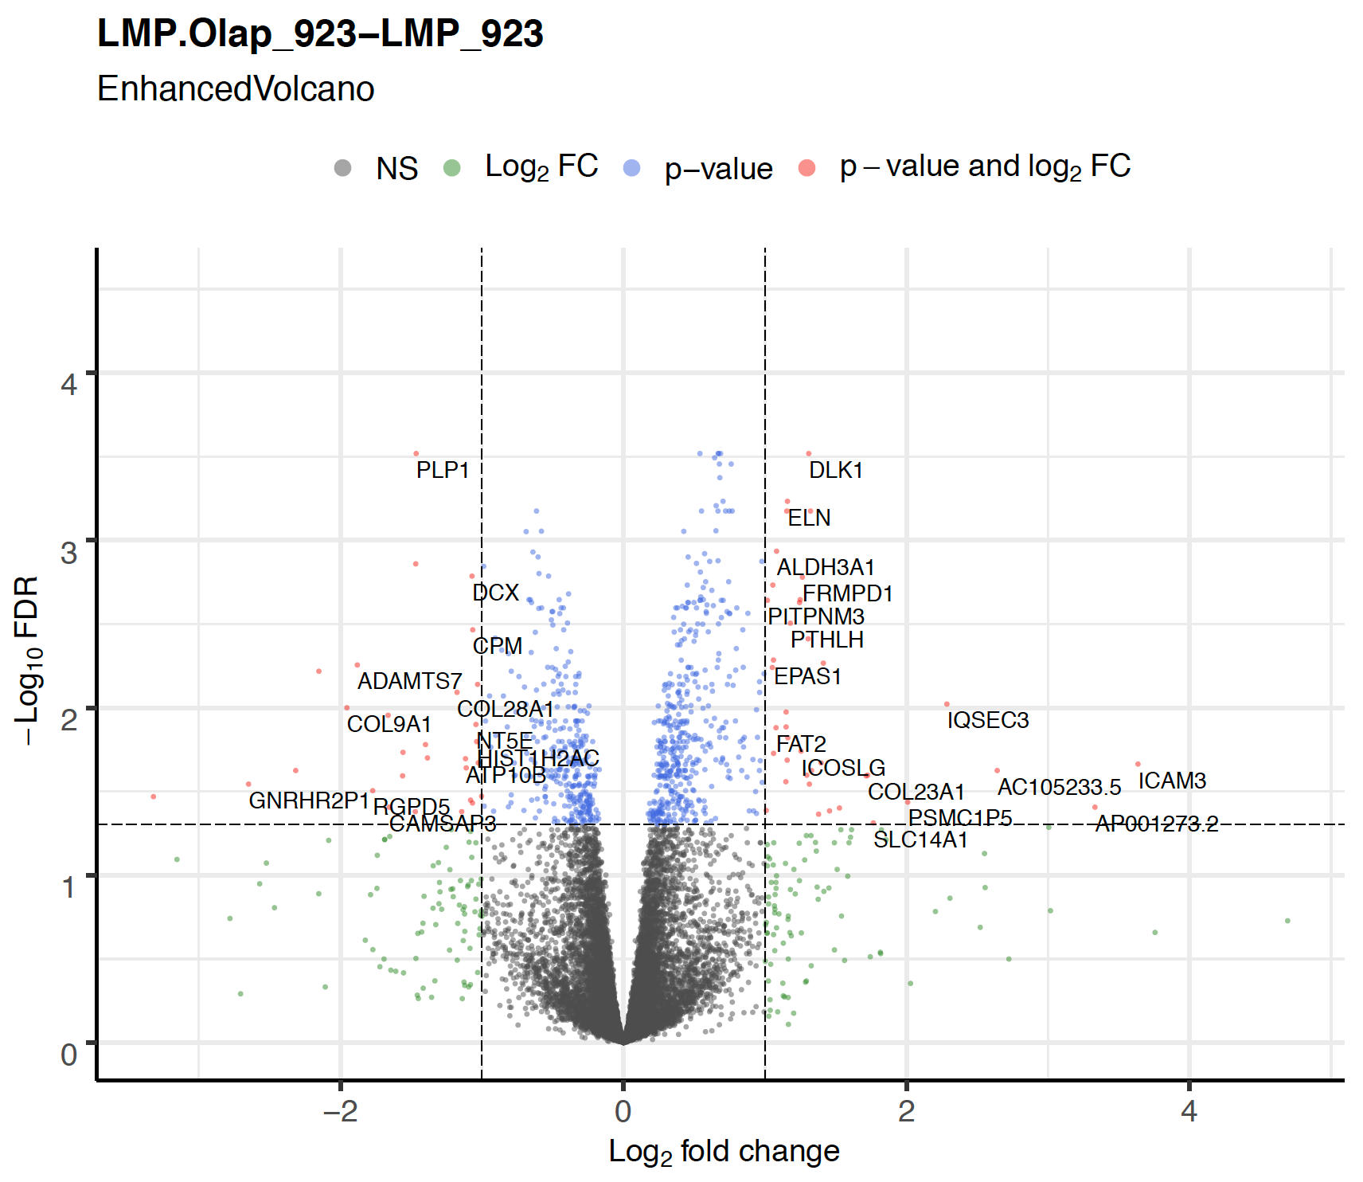
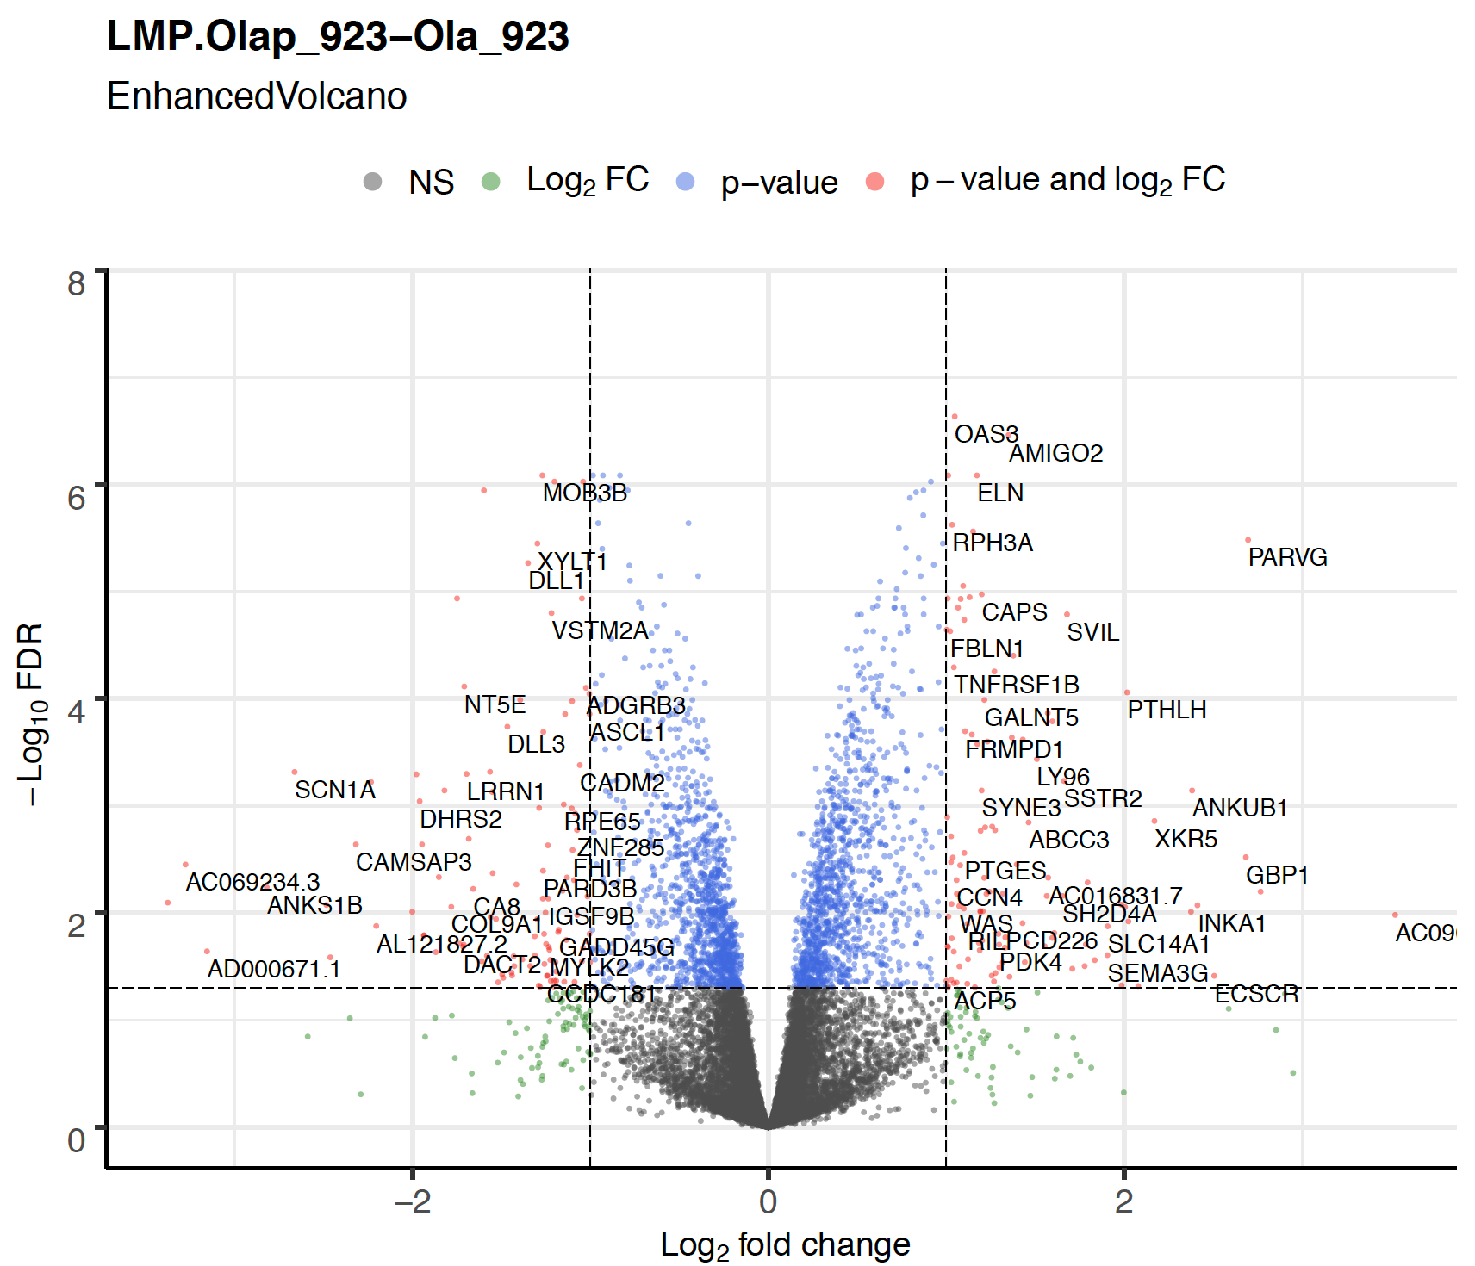
significant DEGs:
log2 > 1 or < -1; -log10FDR > 1.3 (FDR<0.05)

Slide 7
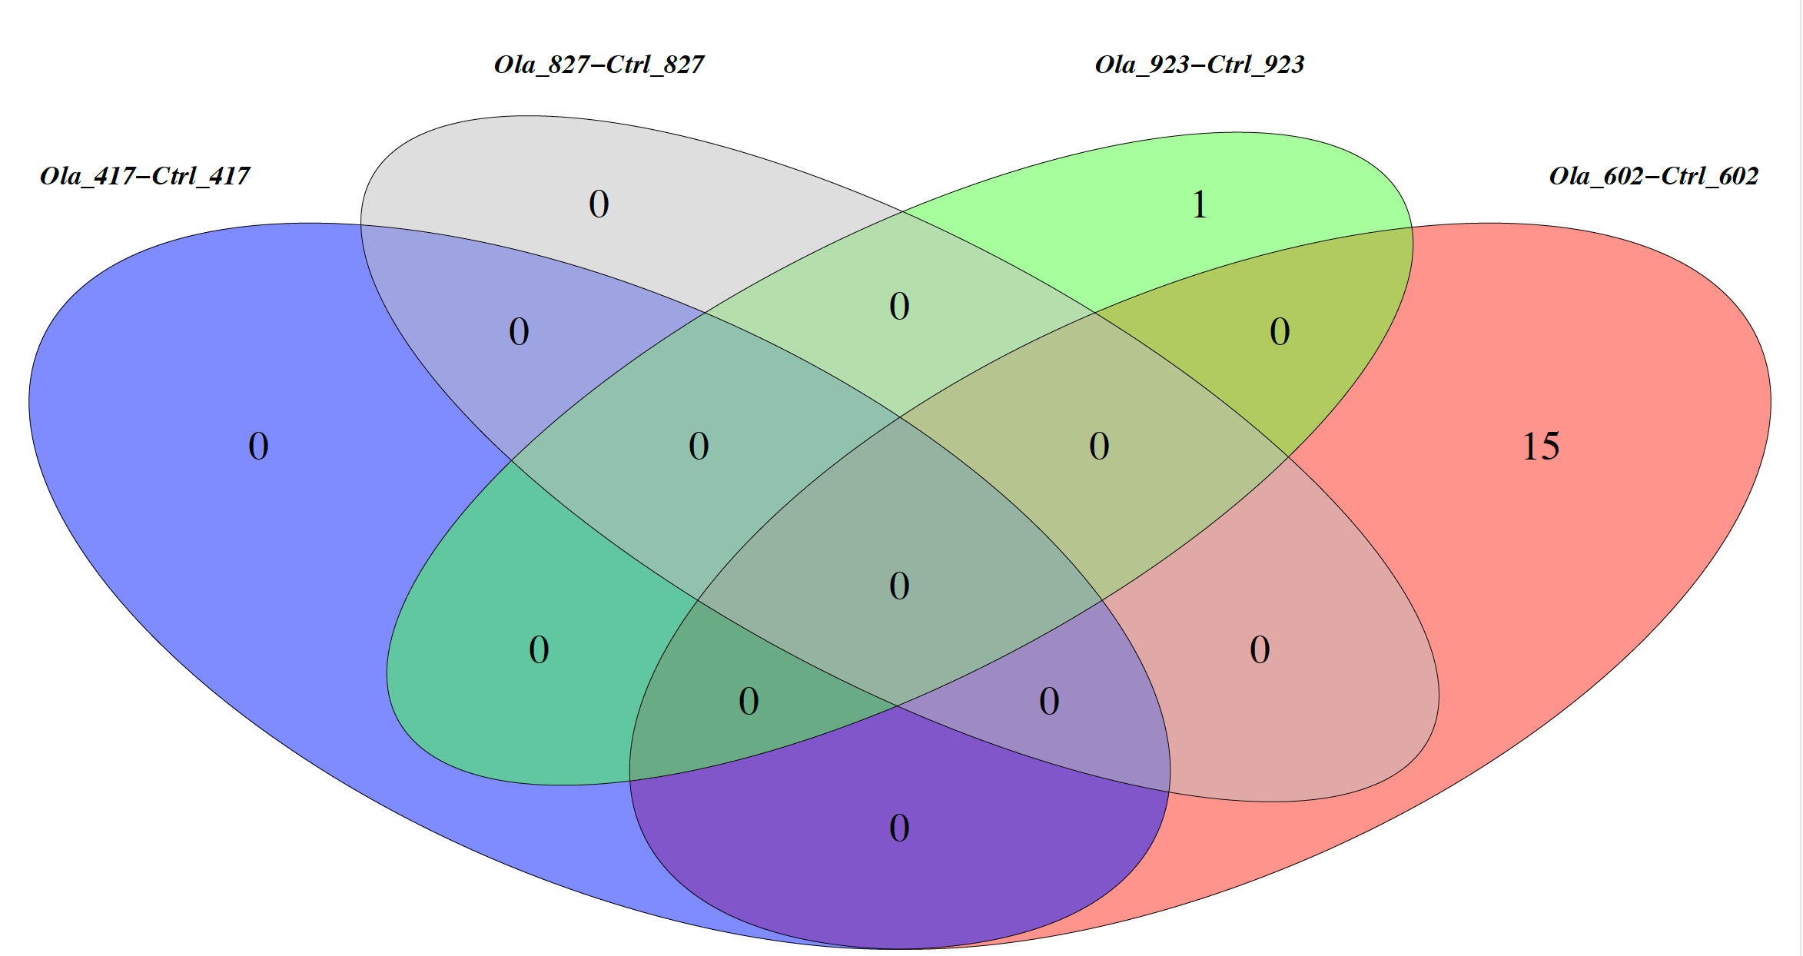
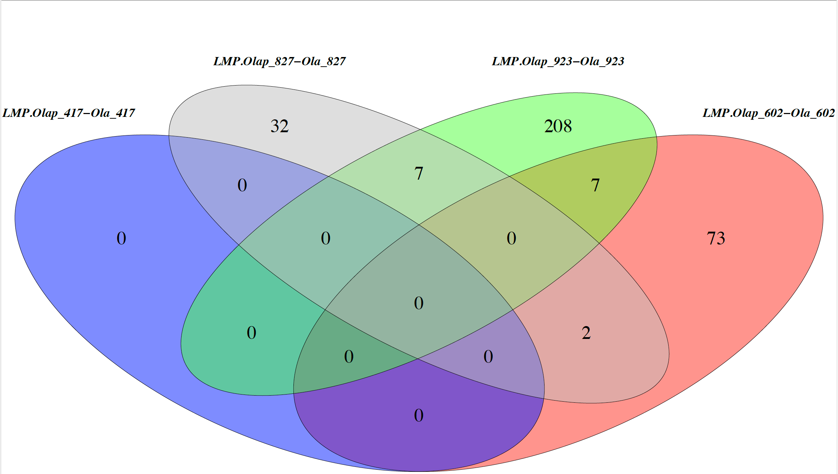


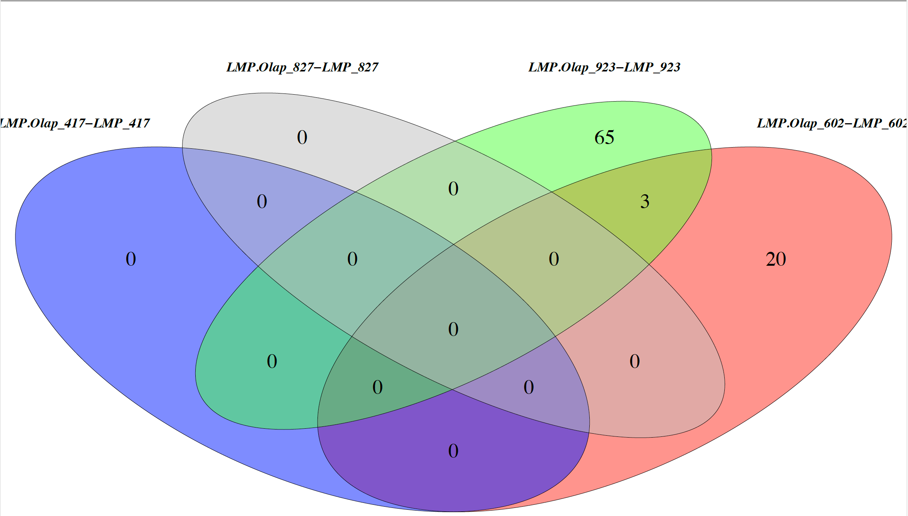
overlap of DEGs for each drug treatment

Slide 8
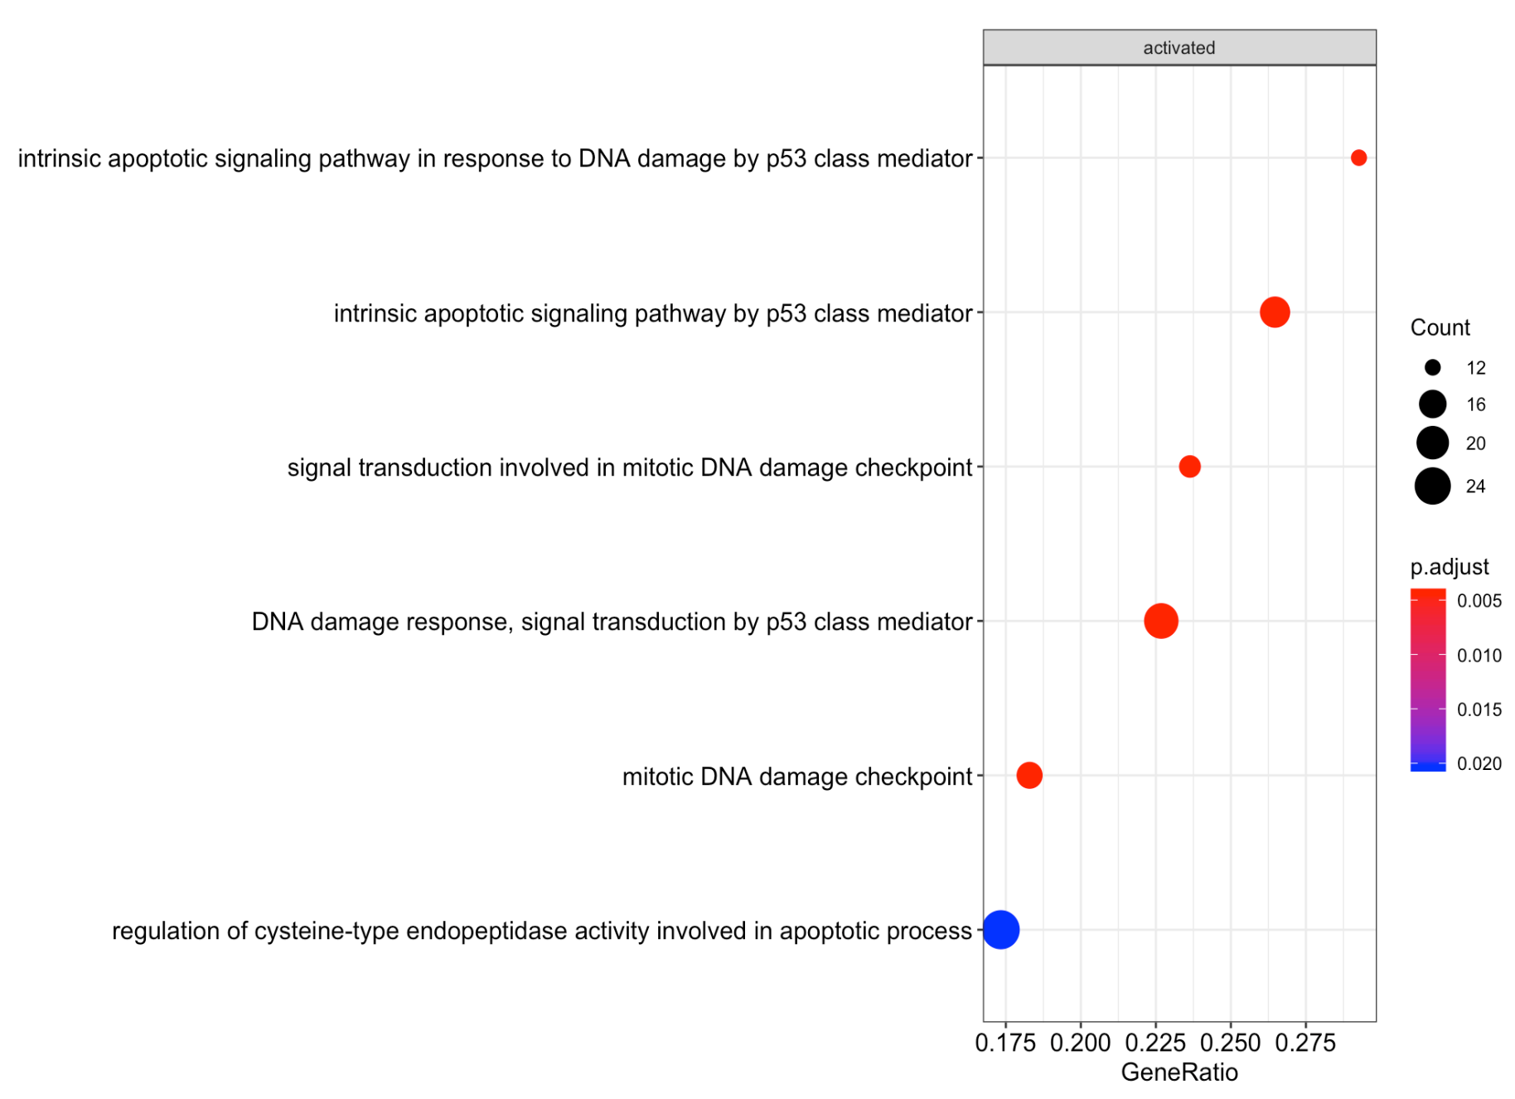
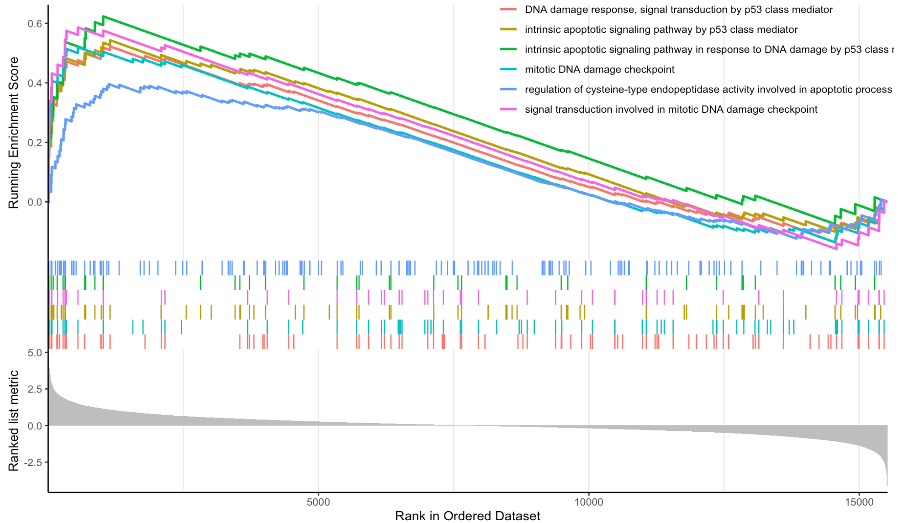
GSEA selected significant pathways for
e.g LMP.Olap_827 - Ctrl_827 Biological process

Slide 9
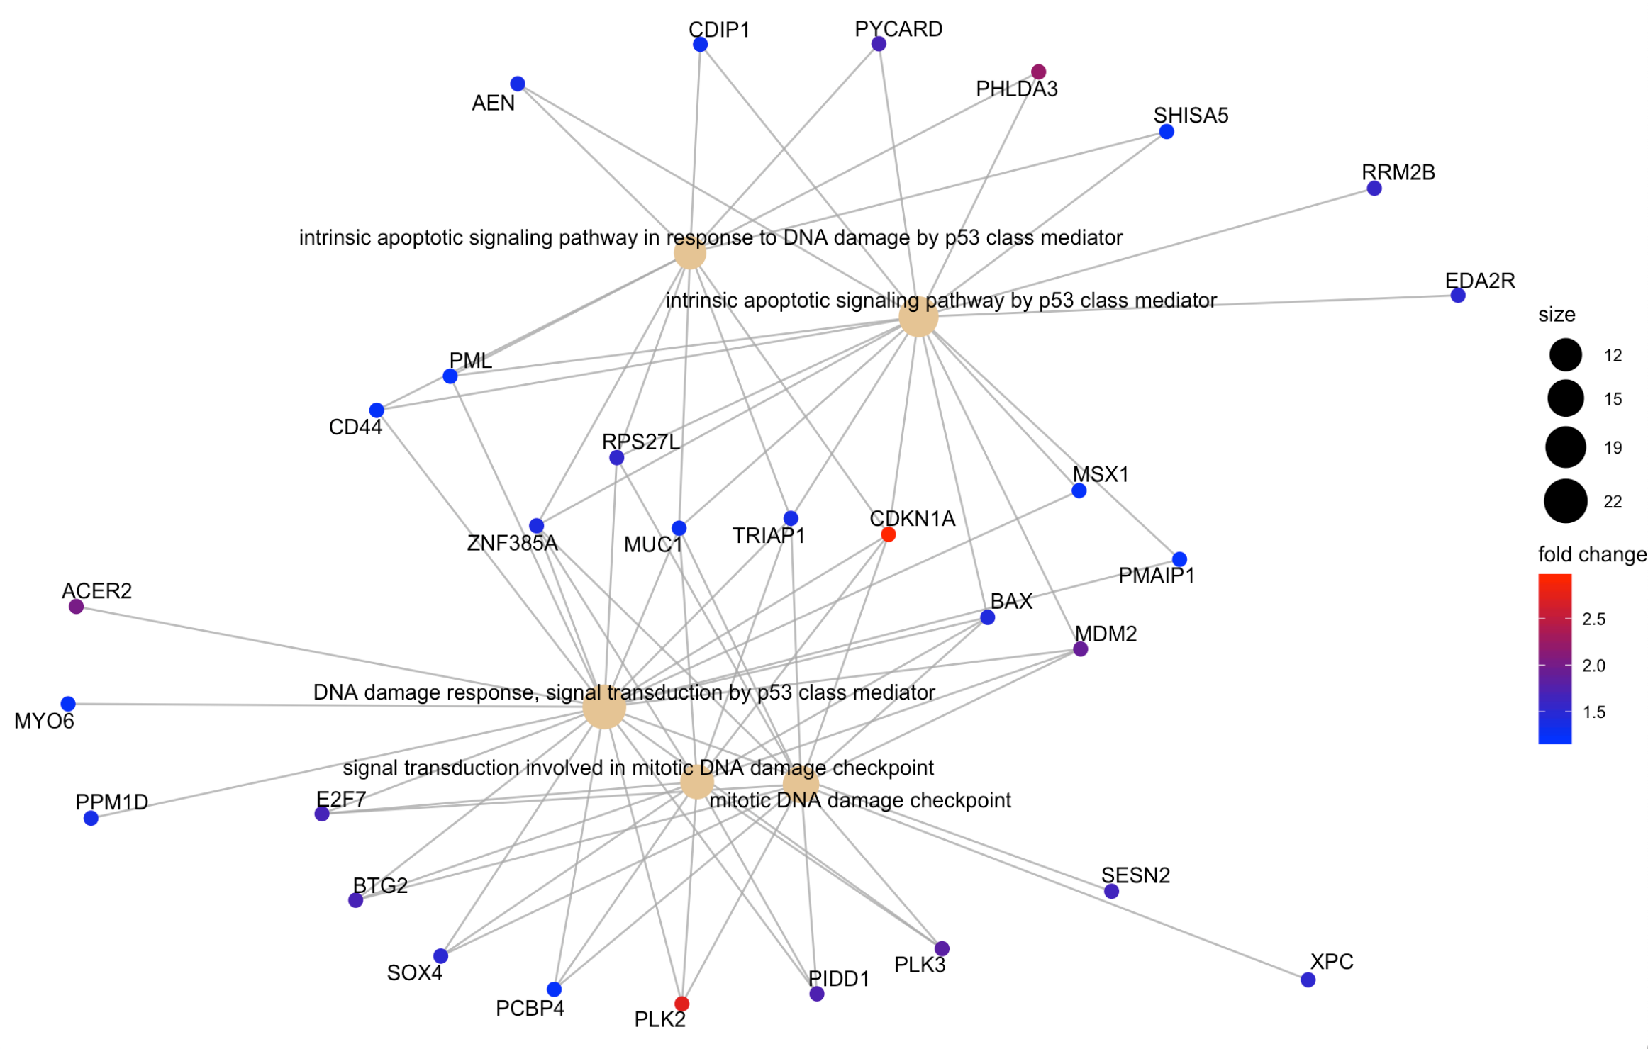
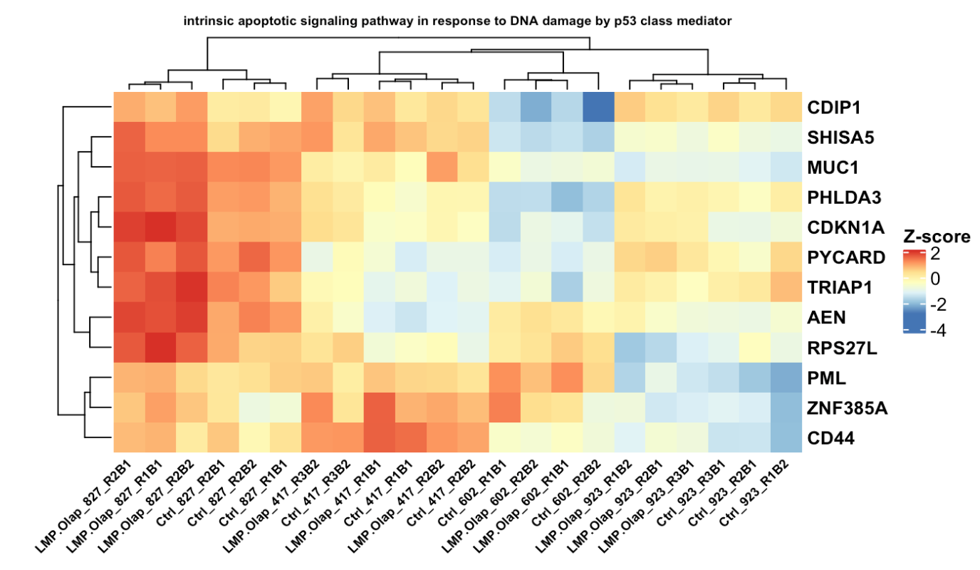
GSEA selected significant pathways and the genes involved in these pathways,
e.g LMP.Olap_827 - Ctrl_827 Biological process

Slide 10
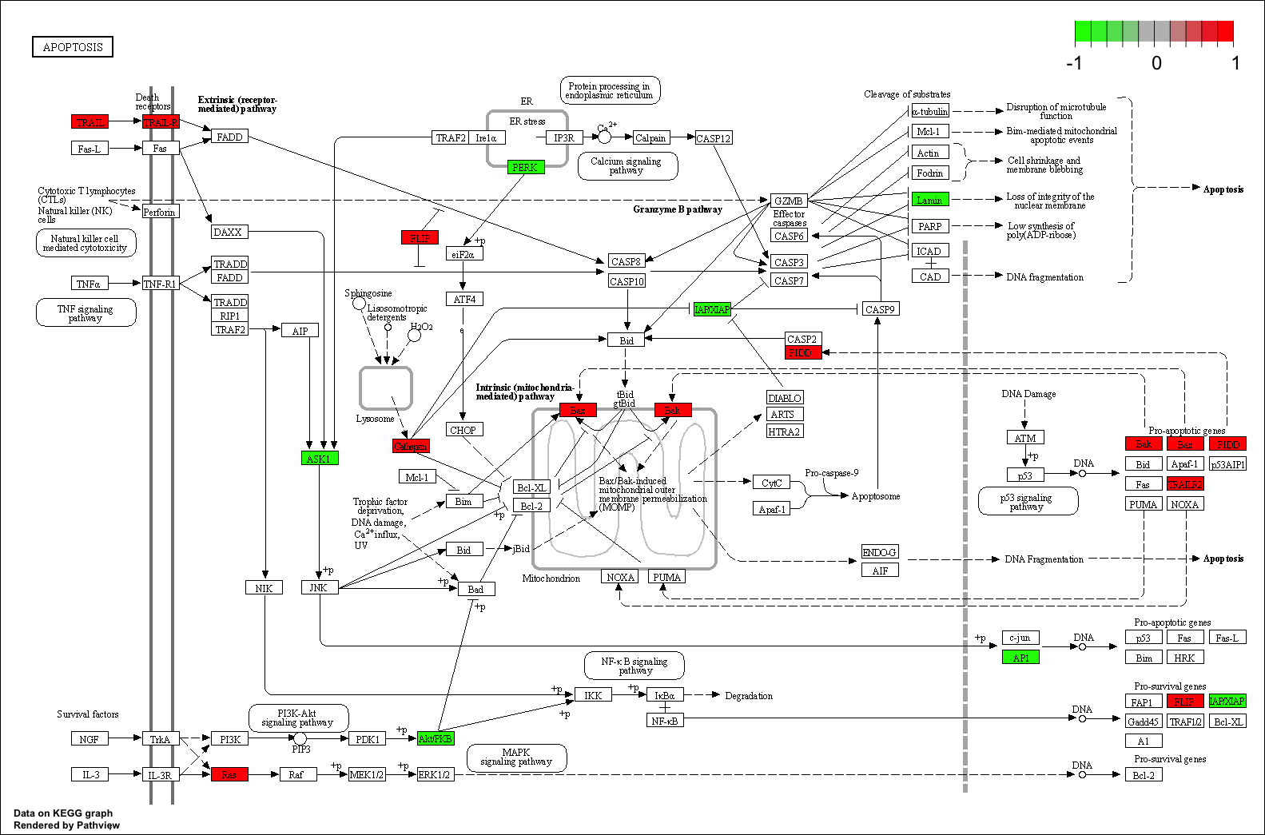
visualizing “apoptosis” pathway, enriched in LMP.Olap_827 - Ctrl_827 KEGG GSEA
Gene differential expression
P value < 0.05
Red: up-regulated
Green: down-regulated

Slide 11
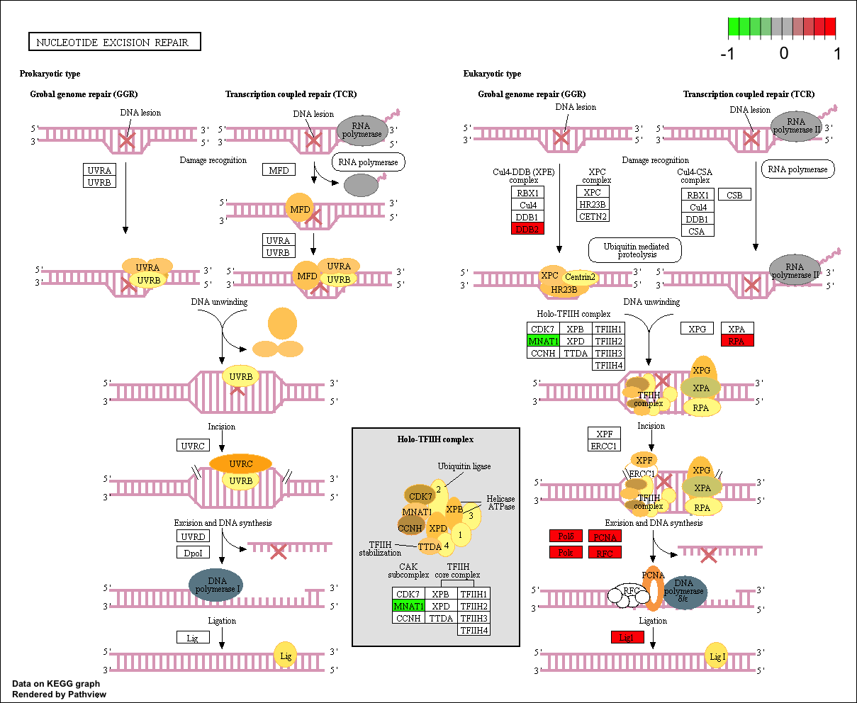
LMP.Olap_Ctrl_602
KEGG pathview:
nucleotide excision repair

Slide 12
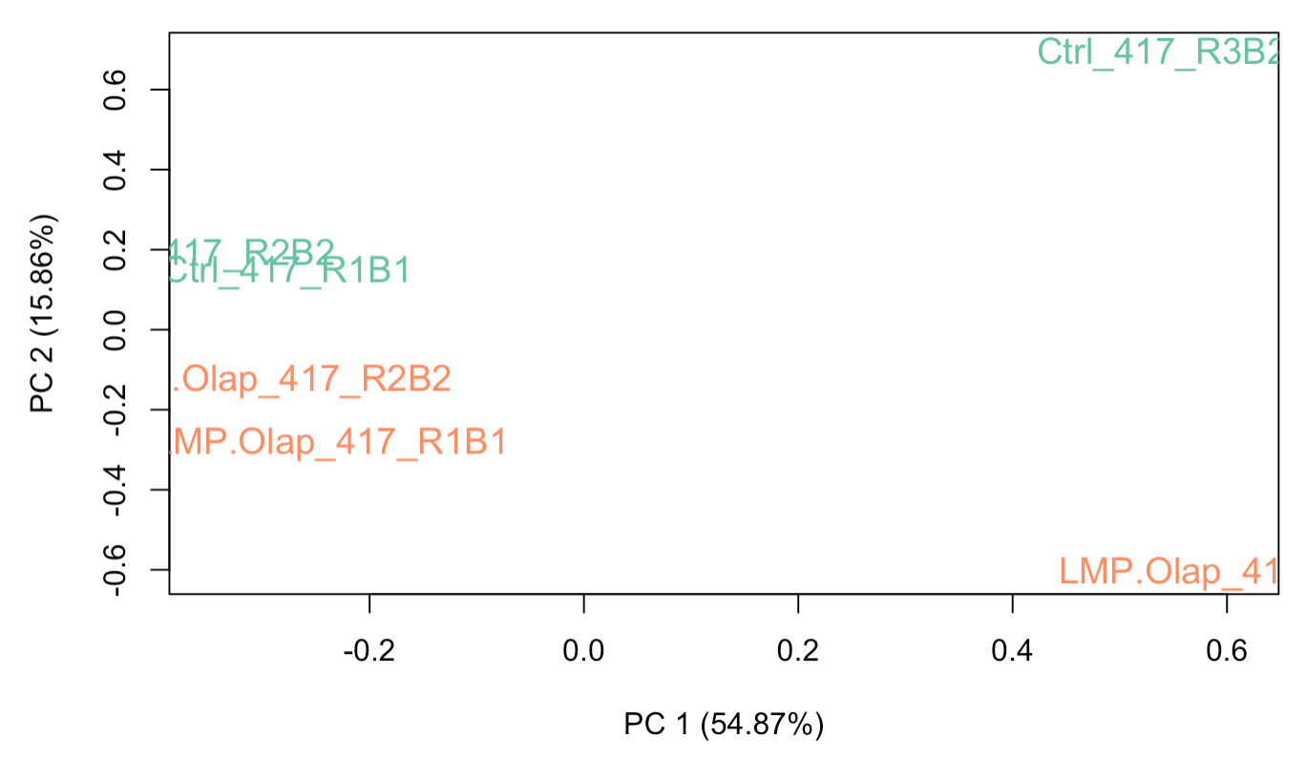
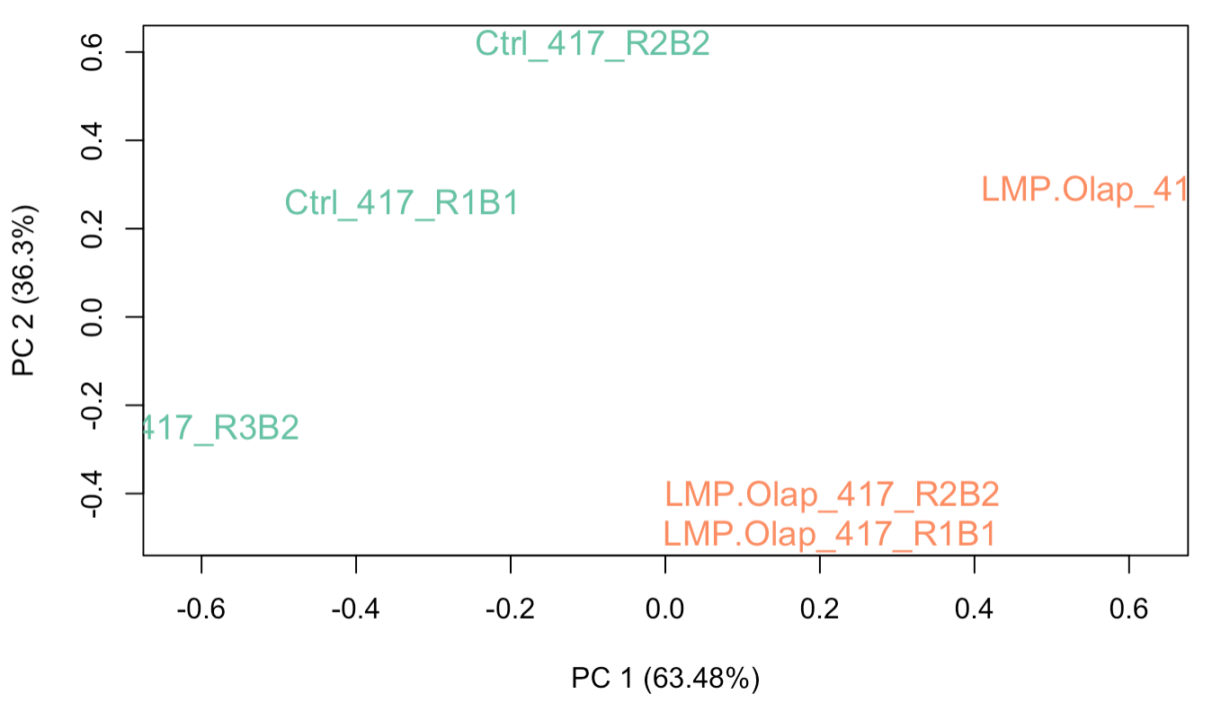
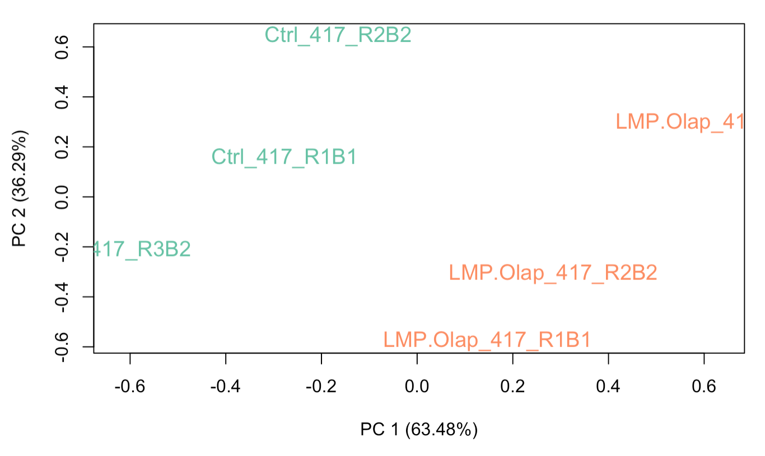
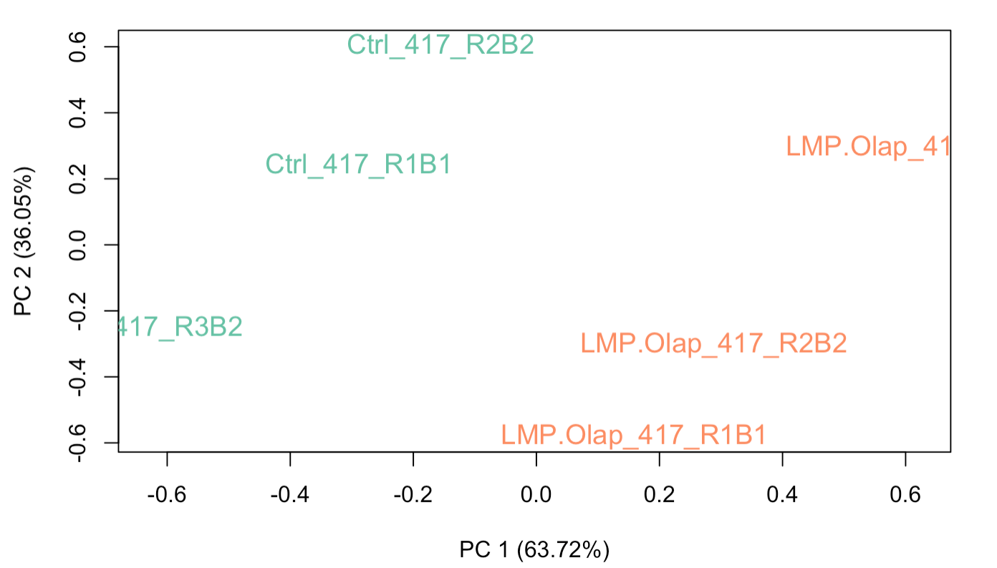
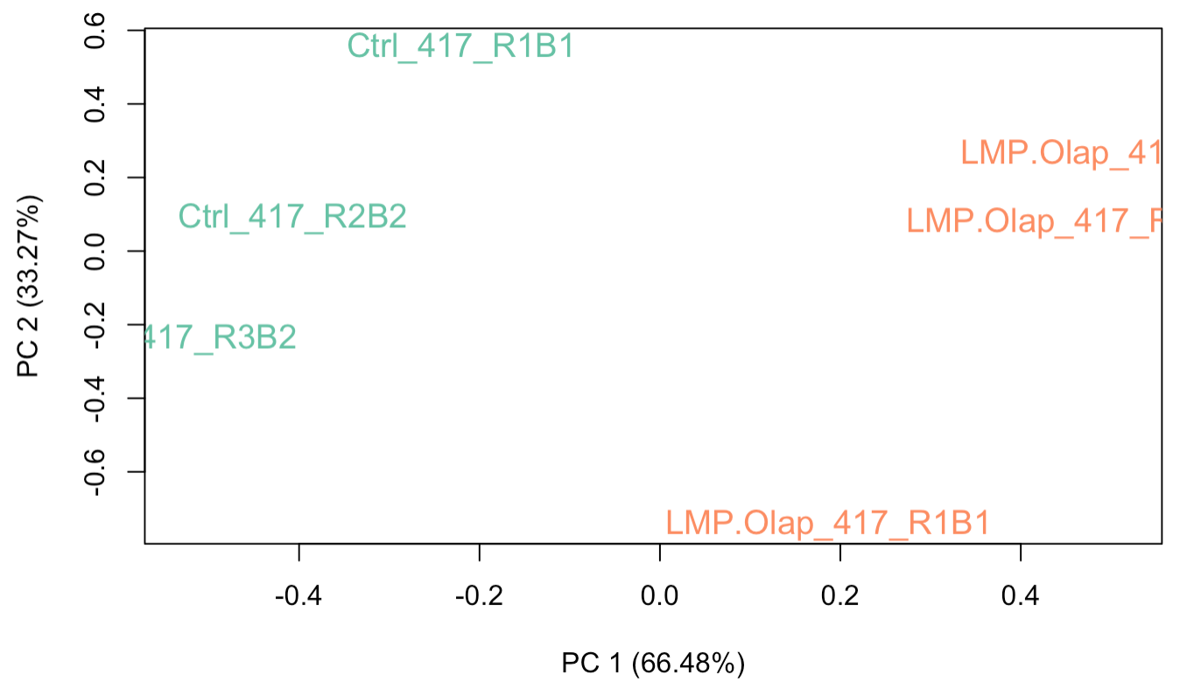
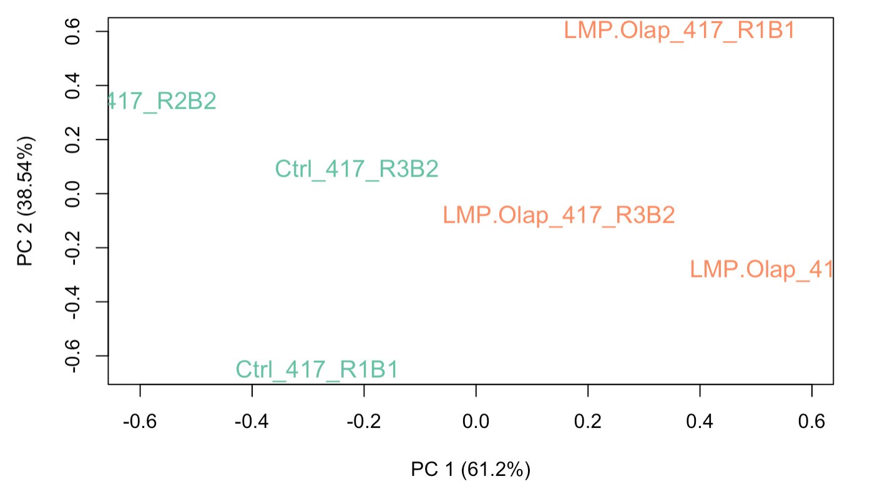
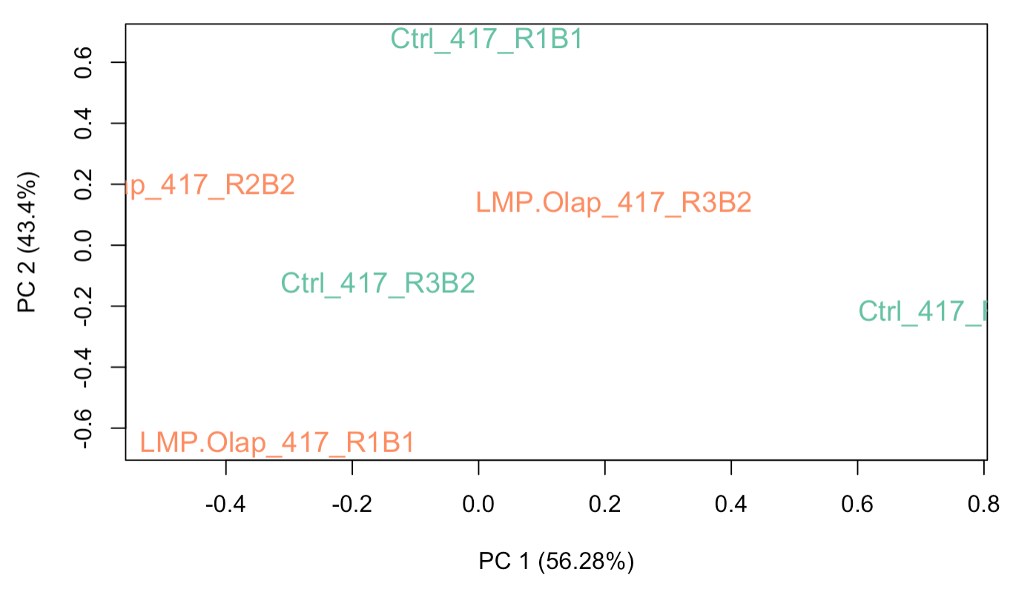
Before RUVg
After RUVg (200 genes with largest Pvalue as control)
After RUVg (500 genes with largest Pvalue)
After RUVg (1500 genes with largest Pvalue)
After RUVg (3000 genes with largest Pvalue)
After RUVg (13000 genes with largest Pvalue)
After RUVg (100 genes with smalles Pvalue)

